Slide 1

Stock price predictions project presentation

Slide 2

Problem statement
Stock Price Analysis and Prediction Based on Historical Data
Contributions
Aziz – Data Gathering, CNN and Report
Ali – ARIMA, LSTM and Report

Slide 3

Companies
1 Equinor ASA
2. Marriott
2. Nestle
4. Microsoft
5. Turkish Airlines

Slide 4
Data gathering & Pre Processing
Yahoo Finance API
Period (2013 – 2022)
Pre-Processing
Missing Values
Volume Traded
Linear Interpolation
Normalizing / Scaling
Train Test Split

Slide 5
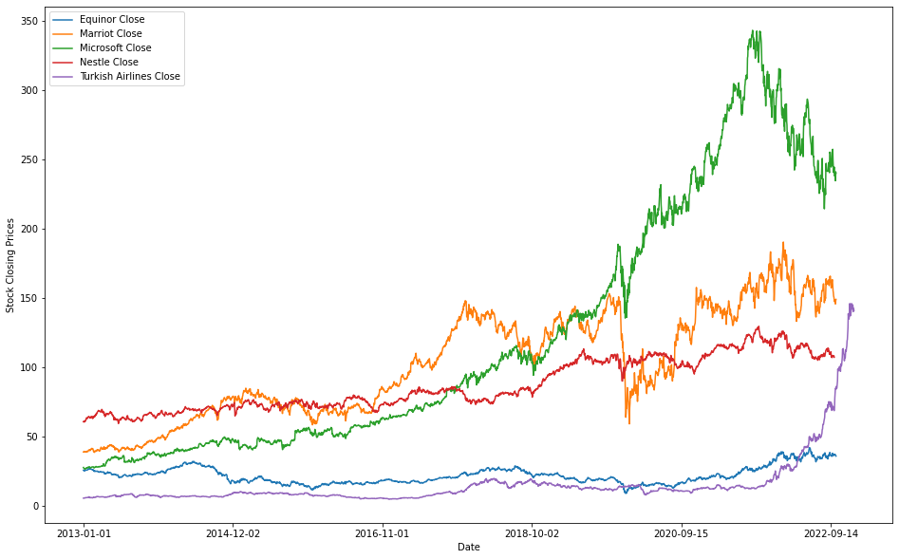
Data gathering & Pre Processing

Slide 6
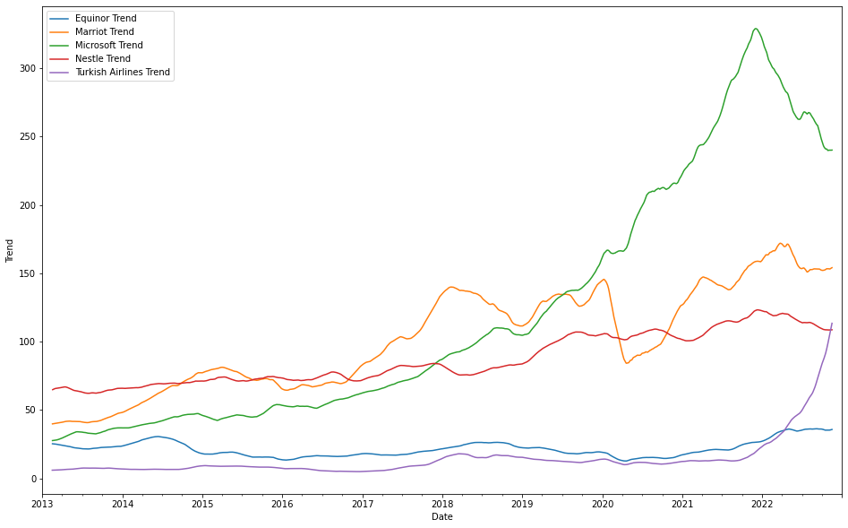
Data gathering & Pre Processing

Slide 7
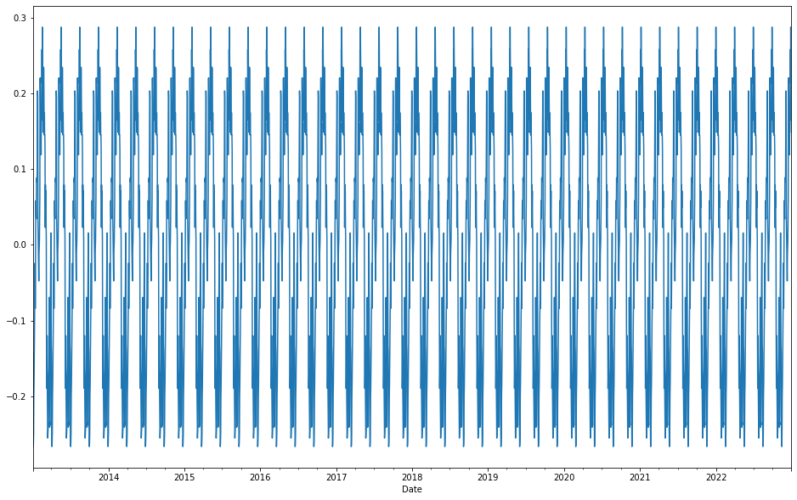
Data gathering & Pre Processing
Equinor

Slide 8
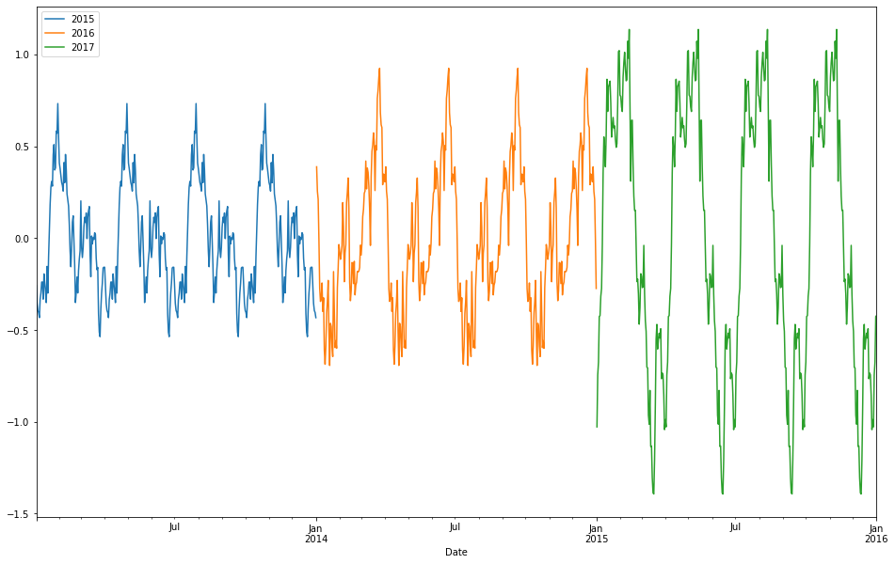
Data gathering & Pre Processing

Slide 9
Models
ARIMA (Statistical Model)
LSTM (RNN)
CNN (ANN)

Slide 10
Arima
Auto Regressive (p)
Integrated (d)
Moving Average (q)
Stationarity
ADF Test
Differencing

Slide 11
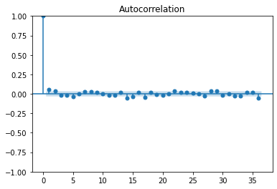
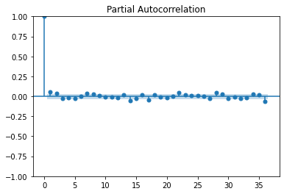
Arima

Slide 12
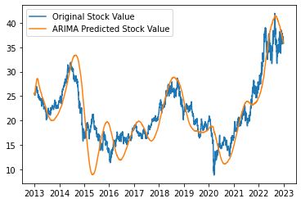
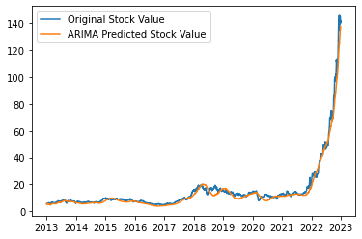
Arima
p = 1, d = 2, q = 2
p = 1, d = 3, q = 3

Slide 13
Neural Networks
Split data into train and test set
Train model on train set
Evaluate models performance
Predict future price of stock

Slide 14
LSTM modeL
Type of RNN
Can retain context from historic values
2 LSTM Layers with 100 Hidden Neurons
1 Dense Layer
1 Output Layer
Inverse Scaling

Slide 15
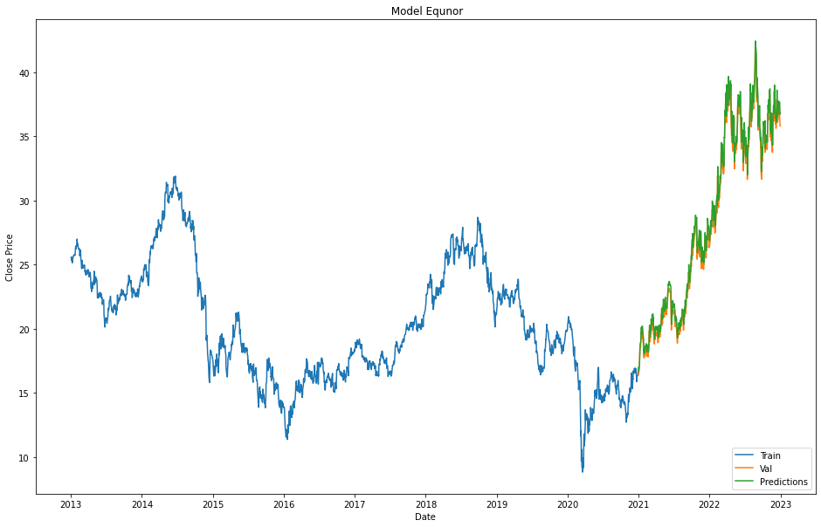
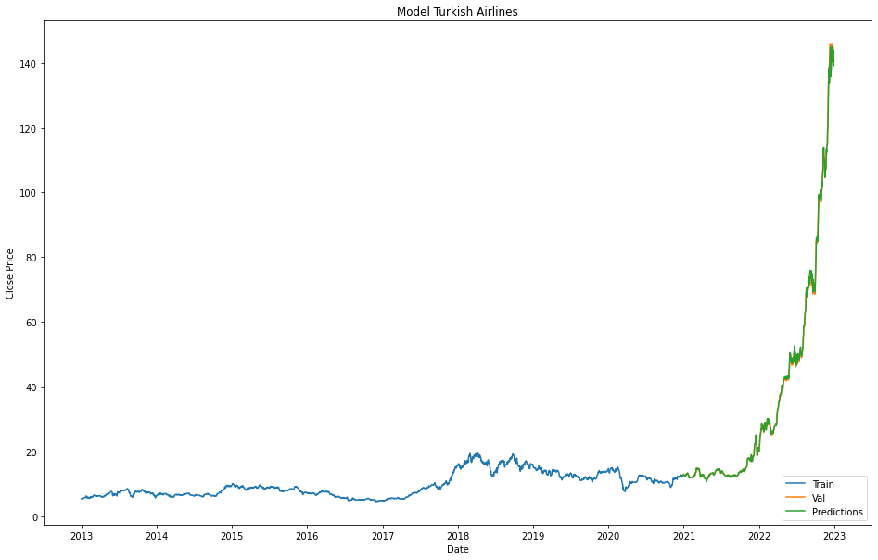
LSTM modeL

Slide 16
1D-CNN modeL
2 CNN layers
6 Kernel Size and 32 Filters
3 Kernel Size and 64 Filters
Pooling layers size 2
Fully connected layers
RELU

Slide 17
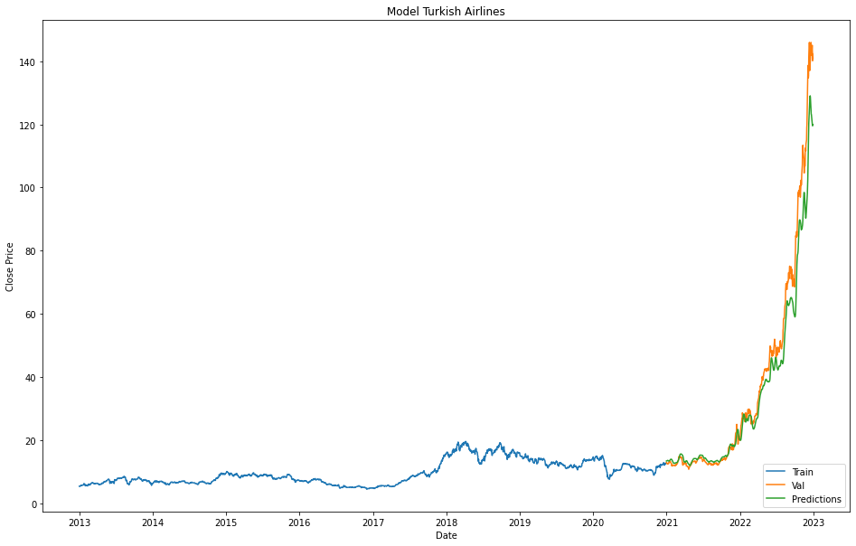
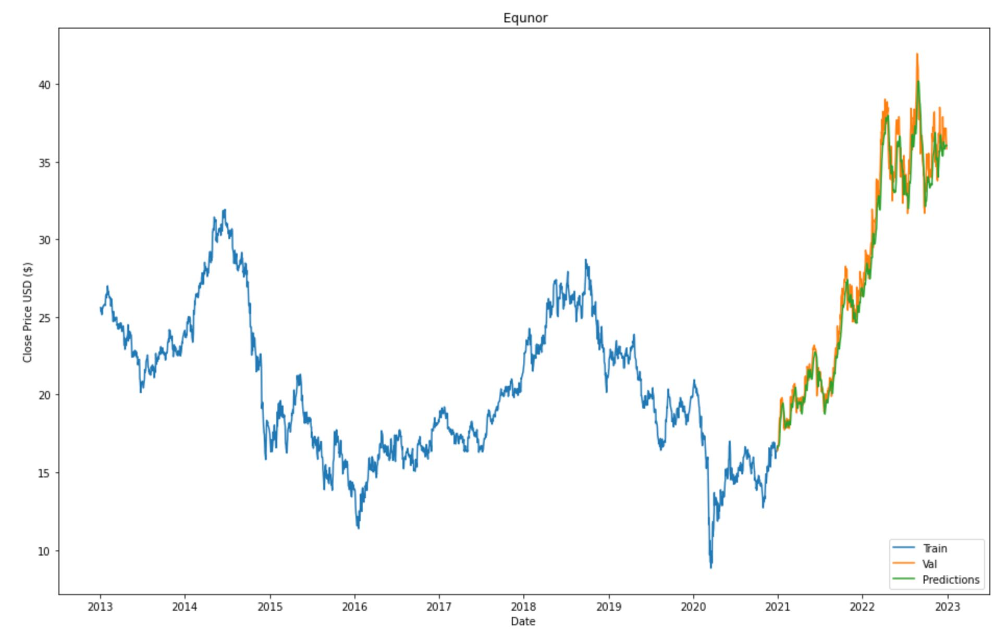
CNN Model

Slide 18
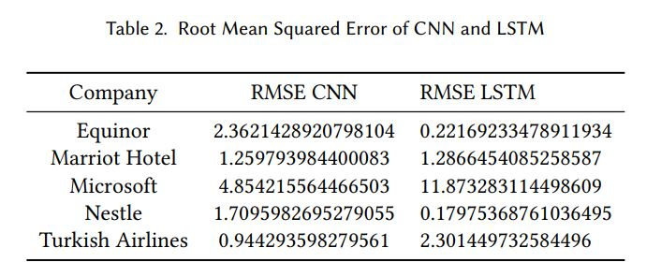
CNN VS LSTM

Slide 19
Conclusion
Very Complicated Domain
ARIMA
LSTM
CNN

